Slide 1
Chapter 1: Introduction
Overview of ICT and Computer Science
Knowledge Hierarchy (Data, Information, Knowledge and wisdom)
What is an Information System?
Components of Information Systems
Applications of IS/ICT

Slide 2
Chapter 1
Computers and Communications: “These are the parents of the information age,” says one writer. “When they meet the fireworks begin.”
Computer Technology: A Computer is a programmable, multiuse machine that accepts data, raw facts, and figures, and processes or manipulates it into information we can use, such as summaries, totals, or reports. Its purpose is to speed up problem solving and increase productivity.
Notes:
Can you give examples of communication devices (technologies) used to transmit large amounts of data through long distances?
ICT can give countries something else to sell. What do you think it is?
Skilled man power as well as products and software!

Slide 3
Communications Technology: Communications, or Telecommunications technologies consist of electromagnetic devices and systems for communicating information over long distances. The principal examples are telephone, radio, broadcast television, cable TV, and other telecom technologies.
Information Technology (IT) is technology that merges computing with high speed communication links carrying data, sound, video, and other forms of multimedia.
Information Communications Technology (ICT) is a generic name used to describe a range of technologies for creating, finding, storing, gathering, retrieving, processing, analysing, sharing, and transmitting information
Notes:
We can say that ICT is about using IT for the benefits of society or groups of people.
We may consider IT as the infrastructure and ICT as applied on top to bring change: they are like body and soul.
ICT is an agent of change and IT is the tool embedded in it!
Sometimes we may loosely take IT and ICT as synonyms (another name for the other): as though both are referring to the same thing
Thus, we use them interchangeably as they fit right based on intellectual experience
ICT can be considered to be built on the 4Cs, Computing, Communications (Connectivity), Content (multimedia), and (human) Capacity
In my view, if we consider large areas and large groups of people (schools for example) ICT comes to the front,
while we consider organizations and industries IT comes to the front.

Slide 4
Cont…
The two technologies were developing independently, before they gradually fused together.
Why have the worlds of computers and telecommunications remained so long before coming together?
Technological Convergence, also known as digital convergence, is the technological merger of several industries through various devices that exchange information in the electronic, or digital, format used by computers. The industries used are Computers, Communications, Consumer Electronics, Entertainment, and Mass media.
What are five developments growing out of the fusion of computers and communications? (refer to using information technology, 9th edition, Williams/Sawyer)
Notes:
Convergence describes the combining of several industries through various devices that exchange data in the format used by computers.
[Q] Can you give some examples of technologies that are results of convergence?
The Cloud, Internet telephony, and Internet through sets are some examples of convergence.
Other telecom services: such as broadband, VPN, etc.
Mass media: Television, Radio, and Newspapers.
The answer to the question is: Computers were digital while most of the world was analog.

Slide 5

What is Computer Science?
CS is designing computing devices and programming them
A lot of work in CS is done with pen and paper!
Computer science is the study of algorithms and much more than this …
A lot of computer science is about improving technology-- making it faster, smaller, cheaper or able to do new things through developing new theories.
Notes:
It is about architecture and abstraction of complex reality.
It is about developing new theories, as a result new technologies can be developed.
Software Engineering is a branch of Computer Science.
Principles (theories) have a long lifetime while technology tends to change every decade or so.
Algorithms are high level abstractions of computer programs.

Slide 6
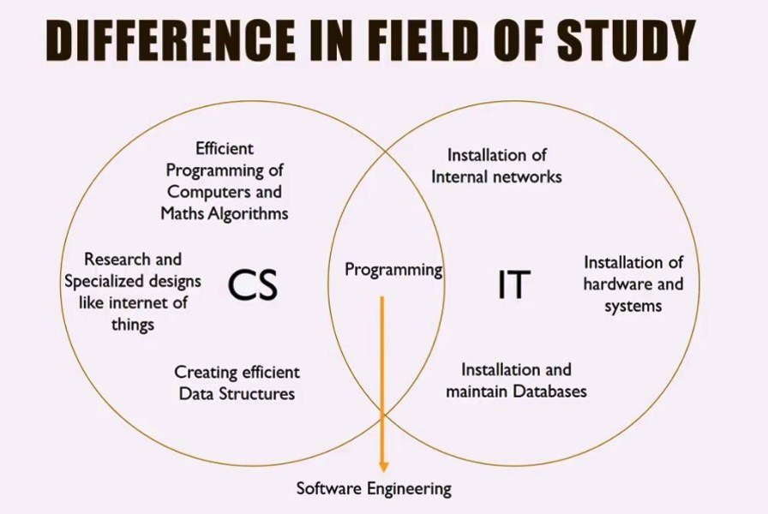
Notes:
IOT and cars! when you approach home the air conditioner will start working …
Trouble shooting through the internet.
Smart fridges, smart cars, smart homes;
Thinking is done in the left, Practical application (of Computers and other Technologies) in the right side
At the overlapping region the two fields work together (through programming).
Successful software development is achieved through Software Engineering principles.

Slide 7
Computer science is programming intensive
Involves
system architecture
software engineering
application programming
hardware engineering
theory
Information Technology is associated to organization related applications
business related
organizational automation
ICT is a Change Agent (Enabler)
Notes:
Architecture: The art or practice of designing and constructing
IT (HW & SW) supports organization processes!
Process → Activities (phases) → Tasks → techniques
Actually HW supports SW, and SW supports Processes (People and their activities)
Computer Science is about analytical thinking and logical reasoning.

Slide 8
Information Concepts
Notes:
Information technology (IT) is a general term that describes any technology that helps to produce, manipulate, store, communicate, and/or disseminate information.
IT merges computing with high-speed communications links carrying data, sound, and video.
Usually Data and information are used interchangeably.
Sometimes Depending on type of recipient.

Slide 9
Data vs. Information
Data: raw facts and figures
Symbols + Rules (Syntax)
Representing events and/or objects or organization
has no meaning
By-product of doing business/transaction
Types of Data
Quantitative (Structured) /material
Qualitative (Unstructured) /textual, image, voice
Financial
Forms of Data
Quantity – weight in KG, volume in liter, …
Quality – taste, choice, …
Currency – Finance in birr, dollar, …
Notes:
[Q] In an organizational setup lower position people use structured data (objective)
while at higher levels unstructured data (subjective) is used. Why is that?
The terms data & information are often used interchangeably. However, there is an important distinction: information is value-added data. Data is processed, organized or transformed to become information.
Data are raw facts. For example, if you write down your age & grade on an English test & hand it to me, I see 2 numbers – raw data. However, if you include the average age and average test score for your class, the data would have some meaning to me as a teacher… it would become information. Interestingly, your name and grade – data to me- could very well be information to you. In the context of your life or experiences, those 2 numbers alone would most likely have meaning.
Similarly, a grocery store manager would most likely find a list of every item sold today to be of little use – it is data. However, the amount that the store’s total sales are over or under planned sales would be information.
Business transactions are events that serve the mission of the business.

Slide 10
Information
Information: collection of facts organized in such a way that they have value beyond the facts themselves
It is data that has been refined and organized by processing and purposeful intelligence;
It is a resource created from a data to serve the management decision making needs of a business.
Sets of Data + meaning (Semantics)
(Sets of data) + (relational connection among data sets)
A red light is a form of data. But when we attach road traffic context to it, it becomes (i.e., STOP) information : Data + Context + Experience
“What we collectively know”
Cognitive state of awareness
Notes:
Semantics = Syntax + meaning
Cognition : The mental action or process of acquiring knowledge through thought, experience, and the senses.
Cognition : Mastewal (Amharic)
We can make decisions based on information we produce or acquire.
People provide the purpose and the intelligence that produces the true information.
The data element “29-01-1986”, for example, may be seen as a string; in a particular context it may, however, be interpreted as the birthdate of a person, and people may use this information to congratulate this person on his birthdate.

Slide 11
Data versus Information
Data = raw facts that represent the characteristics of an event
Example 1:
Event: High temperature
Data: 22° C
Example 2:
Event: Sale
Data: Sale’s date, item number, item description, etc.
Information = facts within a given context
Information results from transforming data by adding context to make it more useful.
The temperature today at noon in Addis was 22° C
P
I
O
Notes:
Information can answer the questions what?, when?, where?, who?. But not how?
If we consider ourselves as a living computer, what is our IPO?
Context = setting/background/environment
The basic (main) operations (work flow activities) of computing : Input, Processing, Output, and storage.

Slide 12
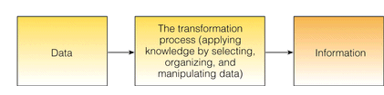
The Process of Transforming Data into Information
Notes:
Information is data that is processed using intelligence.
An ounce of Information is worth a pound of data.
A pound is approximately equal to 12 ounces.

Slide 13
Cont..
Knowledge
Once you spend some time interpreting and understanding a body of information, then you have knowledge
Information + understanding pattern
“What we individually know”, “Your Know-how”
There is information in a telephone book. The knowledge is understanding: Name - referring to a person (telephone subscriber), Number - referring to code enabling to operate the machine, How to use a telephone, How telephone circuit operates, etc
Information with Experience
Cognitive state beyond awareness
Notes:
Knowledge can answer the question How?
Knowledge is about doing things right, but falls short of doing the right thing.
The sum of what is known.
Facts, information, and skills acquired through experience or education;
The theoretical or practical understanding of a subject.
Information held on a computer system. (Knowledge-base, Database)
Knowledge is dynamic. Depends on memory, expertise, exposure, past experiences, opportunities, and the transfer mechanisms
Cognition : Mastewal++ (Amharic)
Pattern : a recurring regular form or sequence
Recurring : Occurring again and again

Slide 14
Cont…
The process of creating knowledge is time taking. Technology has greatly reduced the cost involved in assembling and storing data, and in transferring and storing information. Creating knowledge still takes human brain, human thoughts and time - especially today when there is too much information available
"You don't just learn knowledge; you have to create
it. Get in the driver's seat, don't just be a passenger.
You have to contribute to it or you don't understand
it." (Dr. W. Edwards Deming)
Notes:
Technology has not done anything to make the process of creating knowledge any quicker or cheaper.
You have to ask and debate to contribute.

Slide 15
Cont…
Wisdom
The state of being wise: Acting based on broader perspective, From self-interest towards social contribution, to create a better future grounded on the past experience;
Informed by multiple forms of intelligence : Reason, Intuition, Spirit, Values
Knowledge + Principles (ethics, Values)
What do we mean by Ethics?
Is there any possible knowledge hierarchy beyond wisdom?
Notes:
(not to be narrow minded) i.e. thinking out of the box
What type of questions can Wisdom answer? All types of questions including Why?
Ethics: The moral principle governing or influencing conduct. Moral: Concerned with the principles of right and wrong behavior
The highest form of common sense.
To be socially responsible (to be careful about the effects of your actions on other people).
Having or showing experience, knowledge, and good judgement.
Not being biased!
Can an evil person be wise? No! According to definitions of wisdom.
Value: principles or standards of behaviour; one's judgement of what is important in life
:Consider something to be important or beneficial

Slide 16
The Knowledge
Hierarchy
Knowledge on Knowledge;
How, when, and where to apply knowledge
Wisdom
or
Meta-Knowledge
Knowledge: Understanding
of a domain can be applied to
solve problems (Pragmatics)
Information: Lower volume, higher
value, with context and associated
meanings
Data: Large volume, low value, usually no meaning or context
Noise: May contain irrelevant items which obscure data
Notes:
Wisdom is about doing the right thing without blindly following rules!
Information answers what? Knowledge answers How? Wisdom answers all the others including Why?

Slide 17
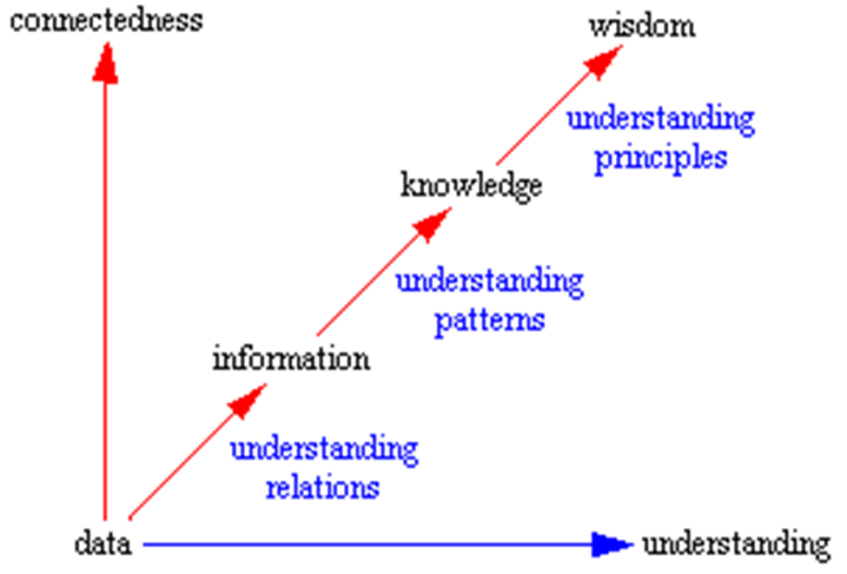
Notes:
As we go up, value increases and volume decreases.
Pattern : a recurring regular form or sequence
Recurring : Occurring again and again

Slide 18
From Facts to Wisdom another form of the hierarchy
Increases as we go down
Increases as we go up
Notes:
Less is more : Compare Sand and Gold
Intelligence : The ability to acquire and apply knowledge and skills
Intelligent : Capable of learning

Slide 19
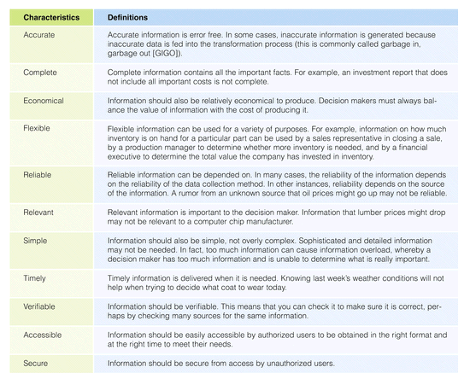
Characteristics of Valuable Information
Notes:
Reproducibility and Transparency can be added to this list, for example.
Transparency : Obvious or evident; Open to public scrutiny.
Ask questions about smaller, faster, and new things?
All that work goes into making technology that works for us. “CS is designing…”
Think about cell phones. They are just tiny computers. Any time you change the ring tone or screen background or launch an app you are running a computer program. A layer of software a human programmer wrote interprets your key strokes so the computer changes how it operates.
Have any of you ever wanted to make a phone work better or differently? [responses]. A lot of computer science is about improving technology-- making it faster, smaller or able to do new things. It’s powerful!

Slide 20
Reading Assignment
Read about tacit and explicit knowledge.
Read about knowledge management.
Notes:
Tacit & Codified Knowledge.

Slide 21
Chapter 1: Introduction
Overview of ICT, CS, and Software Engineering
Knowledge Hierarchy( Data , Information, Knowledge and wisdom) and Knowledge Management
What is a System? What is an Information System?
Applications of IS/ICT
Why study CS?
Notes:
What can you say about the meaning of a system? What is a system?
Can you give examples of a system?

Slide 22
What is a system?
Is a set of interrelated components interacting together to achieve a common goal.
Is a whole containing two or more interacting parts that each of which can affect the properties or behavior of the whole
Basic characteristics :
Emergent properties or behaviors, Hierarchy, Communications, Monitoring and Control Mechanisms
Input, output, environment, process, scope or boundary, objectives, sub-systems, interface, HW, SW, equipment, users;
No property of the Whole can be attributed to only single component of a system.
Notes:
In its simplest form, a system is a set of interrelated components, with a clearly defined boundary, working together to achieve a common set of objectives.
The output is monitored against a set of predefined performance criteria and control action is taken in all essential components if needed.
What is a user interface (UI or GUI)?
[Q] What is the objective of a college? As a system? To produce skilled and marketable graduates!
[Q] Can you signify the four characteristics of a system for humans? [Q] What are the emergent properties of a human system? Life; Our five senses, etc.
A system is a purposeful collection of interrelated components of different kinds that work together to deliver a set of services to the system owner and its users.
A system is an adaptive whole, according to the 4th characteristics!

Slide 23
Systems Thinking
A system is bigger than the sum of its components;
It’s a mind set or way of thinking to view the world (everything in the world) as a system.
It emphasizes on interaction that keeps the system alive.
Before changing the part, you have to demonstrate it improves the whole (Systemic thinking or systemic principle).
Today’s problems are the results of yesterday’s solutions.
Every solution creates new problems.
Notes:
Many systems are very complex to understand and to intervene! A different approach is required (Systems Thinking)
The whole is the product of the interactions of its parts not the sum of its parts taken separately.
It is greater than the sum of its parts. (Human, Car, Bicycle)
There is no total or complete solution for any problem (socio-technical and social systems),
We can only improve the situation. The cure can be worse than the disease (always there are side effects)
Someone’s terrorist is a freedom fighter for others.
Objective and Subjective truth. The hard and soft systems.
A system is a cognitive construct. [It is characterized or influenced by our thought!]
At very high speeds newton’s formulas are not correct! (different solutions for different contexts of the same problem)

Slide 24
Information systems
Are arrangement of people, data, process, interface, communication and IT that interact
to support and improve day-to-day operations in business
support the problem solving and decision making needs of a management and users
Can exist with or without computers
Transform data in to useful information
Notes:
An information system (IS) can be any organized combination of people, hardware, software, communications networks, data resources, and policies and procedures that collects, stores, retrieves, transforms, and disseminates information in an organization.
Why do businesses need IS (and IT)? Currently, IS is supported by IT (CBIS).
To survive in the competition; To sustain their business; To do their work efficiently. To achieve their goal. Support decision making.
The architecture is not just about hardware, software, and telecommunications assets, though that is a key component. It encompasses the people, technology, processes, and data that make up information systems, and it should be driven by business requirements and the organization’s mission.
Patricia Wallace, Introduction to Information Systems, Page 81.

Slide 25
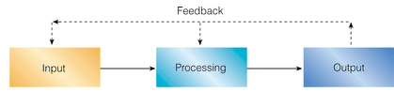
Simplified Information Systems diagram
A System is an adaptive Whole.
Notes:
This may be taken as the functional view of an IS (functional perspective).
Where does the adaptive behaviour of a system come from?
The output is monitored against a set of predefined performance criteria and control action
is taken in all essential components if needed.
Is there any problem associated with making changes through corrective actions?
Yes! The cure might be worse than the disease! Introduction of side effects or bugs (Systems thinking).
The basic (main) operations (workflow activities) of computing : Input, Processing, Output, and Storage.

Slide 26
Components of Computer Based Information Systems
Consider a system for email exchange and list the components participating in the process!
Computer Based Information Systems (CBIS) consist of the following components:
Hardware
Software
Databases (data / information)
Human resources (people )
Procedures (Process)
Telecommunications
Notes:
The data storage hierarchy in databases: Bits -> Characters -> Fields -> Records -> Files -> Database
A Database is a logically organized collection of interrelated data
Process (Procedures): tells about sequence of activities done and who does what using what (org. structure might be hidden here)
Logical : based on valid reasoning
Hardware + Software + Telecommunications = IT
??The five classic components of a computer are input, output, memory, data-path, and control, with the last two sometimes combined and called
the processor. Computer Organization and Design 5th Edition.

Slide 27
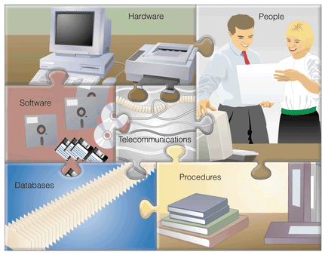
Components of a CBIS
Notes:
A Computer and Communications System (ICT Supported System) is made up of six elements: People, Procedures, Data/Information, HW, SW, and Communications.

Slide 28
Procedures: Strategies, policies, methods, and
rules for using a CBIS.
Telecommunications: Electronic transmission of signals for communication
Hardware: Computer Equipment
Software: Computer Programs
Databases: An organized collections of facts
People: Users, system analysts, programmers, CIO, etc.
Notes:
In some literatures telecommunications can be left out and put into HW & SW.
Procedures (Process) : Sequence of activities done to serve our clients, supported by all other components of the IS.
What will be the components if it were a manual IS?
CIO : Chief Information Officer

Slide 29
General Information Systems Diagram
Management Decisions
(Environment)
Database
Information System
Information
Used
Data
Input
Process
Output
Monitoring
& Control
Feedback
Notes:
This might correctly be called “General Information Systems Work Flow Diagram”??
Where does people, procedures, databases, HW, SW, and Communications fit in this picture?
The output is monitored against a set of predefined performance criteria
Feedback is the result of using and evaluating the system’s product in the environment.

Slide 30
Information Systems
The objectives of a system are realized in its outputs.
Outputs meet requirements of its stakeholders;
The components collect, process or transform, and disseminate data and information.
Manual or automated
Examples
Banking Systems, ERP, DSS/MIS; Airline Reservation Systems; Student Management Systems, HRM, Library Systems, Scheduler, SCM, TPS, Expert Systems, POS in groceries, GIS…
Notes:
Different stakeholders usually have different requirements, sometimes competing or contradicting, adding to system complexity.
Requirements may also be changing frequently for complex systems.
Packaged and in-house developed systems. In-house = within an organization
TPS can be mentioned here!
Departments : Production, sales and purchasing, Logistics, Human resource, Marketing, Finance, IT, Customer support
Transaction: an input message to a computer system dealt with as a single unit of work.
: an instance of doing business
SAP CRM (Customer Relationship Management)
SAP ERP (Enterprise Resource Planning)
SAP PLM (Product Lifecycle Management)
SAP SCM (Supply Chain Management)
SAP SRM (Supplier Relationship Management)
A system is a set of interrelated components (subsystems) that operate together to achieve a common goal.
An information system is a collection of related things that work together to achieve a common goal. The components collect, process or transform, and distribute data and information.
An information system is a specific type of system in general.
Common examples of information systems include: ATMs, point of sale (POS) systems used by grocery checkout clerks; information systems used by airlines to make reservations or schedule flights; and the system you use at your university to register for classes.

Slide 31
Information systems
Information systems use data stored in computer databases to provide needed information.
A database is an organized collection of interrelated data reflecting a major aspect of a firm's activities.
Information systems capture data from the organization (internal data) and its environment (external data).
Store the database items over an extensive period of time.
When specific information is needed, the appropriate data items are manipulated as necessary, and the user receives the resulting information.
Depending on the type of information system, the information output may take the form of a query response, decision outcome, expert-system advice, transaction document, or a report.
Notes:
Information systems are considered as the fundamental elements to achieve business objectives in order to dominate the market place.
Query : Ask a question about something.

Slide 32
Cont…
Data captured by information systems relates to
The operations of the organization internal information.
In a competitive market place, firms need to access more and more external information.
Environment (external data)
the stakeholders of a firm, which includes extended partners and external stakeholders.
Who are the stakeholders of a school?
Notes:
How can an organization collect external information? Using different information systems like a website and social media outlets.
Stakeholder : A person with an interest or concern in something.
Who are the internal and external stakeholders of a school?
Most of the data captured by information systems relates to the operations of the organization itself, serving to produce internal information.
But in an increasingly competitive marketplace, a firm needs to access more and more external information.
Therefore, it is important to note that decision makers need both. A firm can succeed only by adapting itself to the demands of its external environment.
The environment is represented by a number of groups that affect the company's ability to achieve its objectives or that is affected by it. Such groups are called the stakeholders of a firm, which includes both internal and external stakeholders.

Slide 33
Cont…
Effectiveness and Efficiency
The quality of the system may be evaluated in terms of its effectiveness and efficiency
Effectiveness measures the extent to which a system meets its objectives.
Efficiency is a measure of resources consumed to produce given outputs. The fewer resources a system consumes in producing given outputs, the more efficient it is.
Notes:
Efficiency : More output with the same input;
Same output with less input.
Or, even better, more output with less input.
Effectiveness : To make better decisions and to carry out them successfully.
: can be measured through customer and employee satisfaction (stakeholder satisfaction).
: can be measured using ROI = (estimated benefit – initial investment) / (initial investment)
Validation and Verification
An organization is an example of an artificial system.
It is a formal social unit devoted to the attainment of specific goals. It does not emerge naturally - it has to be organized.

Slide 34
Assignment 1
What are the characteristics that make information valuable? Why is each a critical attribute of information?
We all interact with various information systems every day; at the supermarkets, at different organizations, at school, even in cars. Make a list of the different information systems you interact with every day. See if you can identify the technologies, people, and processes involved in making these systems work.
What are the six primary roles that information systems play in organizations? How are information systems used in each context? Refer to Introduction to information systems, Patricia Wallace, 2nd edition.
Notes:
Use Microsoft word or other composing tool to write your answers and submit a printed copy of your work.
Use header and footer, for example, to make it more attractive and informative!

Slide 35
Exercises Cont …
Moodle is an open source learning management system that is used by millions of people worldwide. It is also known as a course management system (CMS) or a virtual learning environment (VLE). Make investigations and write a short paragraph about Moodle. Do you think you can install, configure, and run Moodle at this level of your knowledge? If you manage to do it you can show me and earn bonus!
Make investigations about ERP and Electronic Commerce Systems and write a couple of paragraphs explaining them.
Notes:
Use Microsoft word or other composing tool to write your answers and submit a printed copy of your work.
Use header and footer, for example, to make it more attractive and informative!

Slide 36
Exercises Cont …
N.B.
Use Microsoft word or other composing tools to write your answers and submit a soft copy of your work to abedris@yahoo.com.
Use header and footer, for example, to make your document more attractive and standards based.
Copying others’ work is not allowed. Refer to resources and discuss ideas with others but submit your own answers.
Concise and Precise answers are adequate and recommended.
Due date : Saturday 21 November 2020.
Notes:
Different levels of decision making in an organization rely on different mixes of structured and unstructured information.

